Slide 1
4 Introduction to Probability
Business Statistics:
Communicating with Numbers, 4e
By Sanjiv Jaggia and Alison Kelly
Copyright 2022 © McGraw Hill LLC. All rights reserved. No reproduction or distribution without the prior written consent of McGraw Hill LLC.

Slide 2
Chapter 4 Learning Objectives (L Os)
L O 4.1 Describe fundamental probability concepts.
L O 4.2 Apply the rules of probability.
L O 4.3 Calculate and interpret probabilities from a contingency table.
L O 4.4 Apply the total probability rule and Bayes’ theorem.
L O 4.5 Use a counting rule to calculate the probability of an event.

Slide 3
Introductory Case: 24/7 Fitness Center Annual Membership
A manager at 24/7 Fitness Center wants to develop a data-driven strategy for selecting which new open house attendees to contact.
Data are available from 400 past open house attendees.
Attendee | Age Group | Outcome
1 | Between 30 and 50 | Not Enroll
2 | Over 50 | Enroll
… | … | …
400 | Between 30 and 50 | Enroll
Using the sample information:
a. Construct a contingency table and use it to calculate and interpret relevant empirical probabilities concerning age and enrollment.
b. Use the empirical probabilities to develop a data-driven strategy for selecting open house attendees.

Slide 4
4.1 Fundamental Probability Concepts 1
A probability is a numerical value that measures the likelihood that an event occurs.
Between zero (0) and one (1)
0 → impossible event that never occurs.
1 → a definite event that always occurs.
An experiment is a process that leads to one of several possible outcomes.
Actual outcome is not known with certainty before the experiment begins.
Diversity of outcomes is due to uncertainty.
Example: rolling a fair die.

Slide 5
4.1 Fundamental Probability Concepts 2
Sample space of an experiment.
Denoted S.
Contains all possible outcomes of the experiment.
Examples:
Letter grades in a course:
Passing a course or not:
An event is any subset of outcomes of the experiment.
Simple event if it contains a single outcome.
May contain several outcomes.
Example: a passing grade,

Slide 6
4.1 Fundamental Probability Concepts 3
Exhaustive events.
All possible outcomes of an experiment belong to the events.
Include all outcomes in the sample space.
Mutually exclusive events.
They do not share any common outcomes.
The occurrence of one event precludes the occurrence of others.
Examples:
Grades of A and B are not exhaustive events because they do not include all feasible grades in the sample space. But, the events are mutually exclusive.
Pass and fail are exhaustive and mutually exclusive.

Slide 7
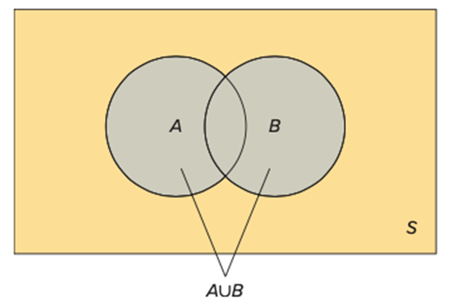
4.1 Fundamental Probability Concepts 4
We can define events based on one or more outcomes of the experiment and also combine events to form new events.
Venn Diagram.
Sample space S with a rectangle.
Two circles to represent the events A and B.
Union of two events.
Denoted
All outcomes in A or B (or both).
The portion in the Venn diagram that is included in either A or B.

Slide 8
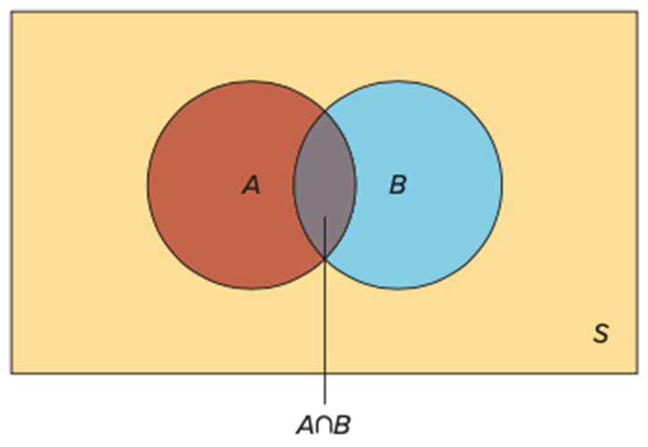
4.1 Fundamental Probability Concepts 5
Intersection of two events.
Denoted
All outcomes in A and B.
The portion in the Venn diagram that is included in both A and B, the overlap.

Slide 9
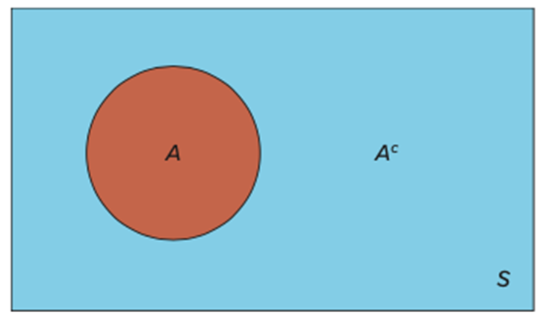
4.1 Fundamental Probability Concepts 6
Complement of an event A.
Denoted
All outcomes in the sample space S that are not in A.
The portion in the Venn diagram that is everything in S that is not included in A.

Slide 10
4.1 Fundamental Probability Concepts 7
Example: the snowboarder’s medal sample space is defined as
A =
B =
C =
no double counting.

Slide 11
4.1 Fundamental Probability Concepts 8
Defining properties of probability.
The probability of an event A is a value between 0 and 1; that is,
The sum of the probabilities of any list of mutually exclusive and exhaustive events equals 1.
There are three types of probabilities.
Subjective: calculated by drawing on personal and subjective judgement.
Empirical: calculated as a relative frequency of occurrence.
Classical: based on logical analysis.
Empirical and classical probabilities do not vary, they are often grouped as objective probabilities.

Slide 12
4.1 Fundamental Probability Concepts 9
Example: snowboarder’s subjective probabilities
Event | Probability
Gold | 0.10
Silver | 0.15
Bronze | 0.20
No medal | 0.55
there are no common outcomes in A and C.

Slide 13
4.1 Fundamental Probability Concepts 10
An empirical probability is calculated as a relative frequency of occurrence.
Referencing data based on observation.
Must be repeated a large number of times to be accurate.
Example: frequency distribution for the ages of the richest 400 Americans.

Slide 14
4.1 Fundamental Probability Concepts 11
Ages | Frequency
< 40 | 13
40 up to 50 | 24
50 up to 60 | 67
60 up to 70 | 113
70 up to 80 | 117
80 up to 90 | 55
≥ 90 | 11
What is the probability that the individual is at least 50 but less than 60?
What is the probability that the individual is younger than 60?
What is the probability that the individual is at least 80?

Slide 15
4.1 Fundamental Probability Concepts 12
Example continued,
Ages | Event | Frequency | Relative Frequency
< 40 | A | 13 | 13/400 = 0.0325
40 up to 50 | B | 24 | 0.0600
50 up to 60 | C | 67 | 0.1675
60 up to 70 | D | 113 | 0.2825
70 up to 80 | E | 117 | 0.2925
80 up to 90 | F | 55 | 0.1375
≥ 90 | G | 11 | 0.0275
The following table read 13/400 = 0.0325 as “13 divided by 400 equals 0.0325"

Slide 16
4.1 Fundamental Probability Concepts 13
What is the probability that the individual is at least 50 but less than 60?
What is the probability that the individual is younger than 60?
What is the probability that the individual is at least 80?

Slide 17
4.1 Fundamental Probability Concepts 14
A classical probability is based on logical analysis rather than observation.
A narrow range of well-defined problems, games of chance.
Based on assumptions that all the outcomes are equally likely.
Computed as number of outcomes belonging to an event divided by total number of outcomes.
According to the law of large numbers, the empirical probability approaches the classical probability if the experiment is run a very large number of times.
Example: heads on a coin.
Flip a coin 10 times, heads may not show up 5 times.
Flip a coin a large number of times, heads will show up about half of the time.

Slide 18
4.1 Fundamental Probability Concepts 15
Example: suppose our experiment consists of rolling a six-sided die.
What is the probability that we roll a 2?
What is the probability that we roll a 2 or 5?
What is the probability that we roll an even number?

Slide 19

4.2 Rules of Probability 1
Complement rule,
Follows from one of the defining properties of probability:
Rearrange:

Slide 20
4.2 Rules of Probability 2
Example: 37% of female open house attendees will purchase a membership. What is the probability that a randomly selected female will not purchase a membership?
Define A as the event that a randomly selected female will purchase a membership.

Slide 21
4.2 Rules of Probability 3
Addition rule,
Used to find the probability of the union of two events.
The probability that A or B occurs, or that at least one of these events occurs.
is double-counted in both
is referred to as the joint probability.

Slide 22
4.2 Rules of Probability 4
Example: Anthony feels that he has a 75% chance of getting an A in Statistics and a 55% chance of getting an A in Managerial Economics. He also believes he has a 40% chance of getting an A in both classes.
a. What is the probability that he gets an A in at least one of these courses?
b. What is the probability that he does not get an A in either of these courses?

Slide 23
4.2 Rules of Probability 5
Let
correspond to the probability of getting an A in Statistics,
Let
correspond to the probability of getting an A in Managerial
Economics,
Also,
a.

Slide 24
4.2 Rules of Probability 6
b. The probability that he does not receive an A in either of these two courses is the complement of the union.
That is,
Using the complement rule we have,

Slide 25
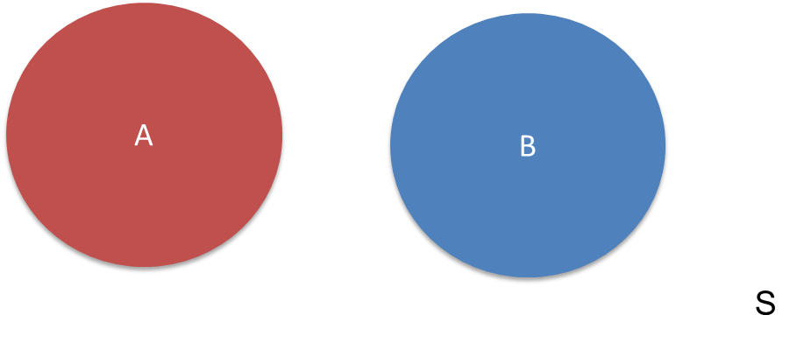
4.2 Rules of Probability 7
For mutually exclusive events A and B, the probability of their
intersection is zero
There is no double counting.
Access the text alternative for slide images.

Slide 26
4.2 Rules of Probability 8
Suppose the probability that a recent business college graduate finds a suitable job is 0.80.
Let A represent finding a job,
This is not conditional on another event, so it is an unconditional probability.
The probability of finding a suitable job is 0.90 if the recent business graduate has prior work experience.
Let B represent prior work experience,
The probability of an event is conditional on the occurrence of another event, so it is a conditional probability.
The probability of finding a suitable job increases from 0.80 to 0.90 when conditioned on prior work experience.

Slide 27
4.2 Rules of Probability 9
The conditional probability,
is greater than the
unconditional probability
when B exerts a positive influence
on A.
The conditional probability,
is less than the unconditional
probability
when B exerts a negative influence on A.

Slide 28
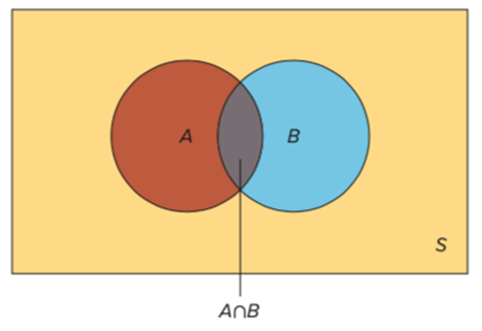
4.2 Rules of Probability 10
Let two events A and B each have a positive probability of occurring.
The conditional probability that A occurs given that B has occurred is derived
as
Because
is conditional on B (B has occurred), the sample space
reduces to B.
portion in the Venn
diagram that is included in B.
Similarly,

Slide 29
4.2 Rules of Probability 11
Example: An economist predicts a 60% chance that country A will perform poorly and a 25% chance that country B will perform poorly. There is also a 16% chance that both countries will perform poorly.
What is the probability that country A performs poorly given that country B performs poorly?

Slide 30
4.2 Rules of Probability 12
Let A represent the event that country A performs poorly,
Let B represent the event that country B performs poorly,
The probability that country A performs poorly and country B
performs poorly is
The probability that country A performs poorly given country B
performs poorly is
The conditional probability is greater than the unconditional probability, so country B performing poorly exerts a positive influence on country A performing poorly.

Slide 31
4.2 Rules of Probability 13
We can find the joint probability as the product of probabilities using the conditional probability formula; this is the multiplication rule.
The joint probability of events A and B is derived as
Example: A manager believes that 14% of consumers will respond positively to the firm’s social media. Also, 24% of those who respond positively will be come loyal customers.
What is the probability that the next recipient of their social media campaign will react positively and become a loyal customer?

Slide 32
4.2 Rules of Probability 14
Example continued.
Let R represent the event that a consumer who responds positively to
a social media campaign, so
Let L represent the event that a consumer is loyal, so
The probability that a consumer responds positively to a social media campaign and is loyal is given by

Slide 33
4.2 Rules of Probability 15
Two events are independent if the occurrence of one event does not affect the probability of the occurrence of the other event.
Events are considered dependent if the occurrence of one is related to the probability of the occurrence of the other event.
Two events, A and B, are independent if,

Slide 34
4.2 Rules of Probability 16
Example: Suppose that for a given year there is a 2% chance that your desktop computer will crash and a 6% chance that your laptop computer will crash.
Moreover, there is a 0.12% chance that both computers will crash.
Is the reliability of the two computers independent of each other?

Slide 35
4.2 Rules of Probability 17
Example continued,
Let D represent the outcome that your desktop crashes,
Let L represent the outcome that your laptop crashes,
The joint probability is
Calculate
So,
If your laptop crashes, it does not alter the
probability that your desktop also crashes.
The reliability of the two computers is independent.

Slide 36
4.3 Contingency Tables and Probabilities 1
A contingency table is useful when examining the relationship between two categorical variables.
It shows the frequencies for two categorical variables, x and y.
Each cell represents a mutually exclusive combination of the pair of x and y values.
We can estimate an empirical probability by calculating the relative frequency to the occurrence of the event.

Slide 37
4.3 Contingency Tables and Probabilities 2
Example: enrollment and age group from the introductory case.
Outcome | Age Group of Under 30 (U) | Age Group of Between 30 and 50 (B) | Age Group of Over 50 (O) | Total
Enroll (E) | 24 | 72 | 44 | 140
Not Enroll (N) | 84 | 88 | 88 | 260
Total | 108 | 160 | 132 | 400
a. What is the probability that a randomly selected attendee enrolls in the fitness center?
b. What is the probability that a randomly selected attendee is over 50 years old?
c. What is the probability that a randomly selected attendee enrolls in the fitness center and is over 50 years old?
d. What is the probability that an attendee enrolls in the fitness center, given the attendee is over 50 years old?

Slide 38
4.3 Contingency Tables and Probabilities 3
Example continued,
Outcome | Age Group of Under 30 (U) | Age Group of Between 30 and 50 (B) | Age Group of Over 50 (O) | Total
Enroll (E) | 24 | 72 | 44 | 140
Not Enroll (N) | 84 | 88 | 88 | 260
Total | 108 | 160 | 132 | 400
Let E denote the event of enrolling in the fitness center.
Let O denote the event of being over 50 years old.
a. What is the probability that a randomly selected attendee enrolls in the fitness center?
b. What is the probability that a randomly selected attendee is over 50 years old?

Slide 39
4.3 Contingency Tables and Probabilities 4
Example continued,
Outcome | Age Group of Under 30 (U) | Age Group of Between 30 and 50 (B) | Age Group of Over 50 (O) | Total
Enroll (E) | 24 | 72 | 44 | 140
Not Enroll (N) | 84 | 88 | 88 | 260
Total | 108 | 160 | 132 | 400
c. What is the probability that a randomly selected attendee enrolls in the fitness center and is over 50 years old?
d. What is the probability that an attendee enrolls in the fitness center, given the attendee is over 50 years old?

Slide 40
4.3 Contingency Tables and Probabilities 5
A more convenient way of calculating relevant probabilities is to convert the contingency table to a joint probability table.
Divide the frequency in each cell by the number of outcomes.
The values in the margins of the table represent unconditional probabilities also referred to as marginal probabilities.
Outcome | Age Group of Under 30 (U) | Age Group of Between 30 and 50 (B) | Age Group of Over 50 (O) | Total
Enroll (E) | 0.06 | 0.18 | 0.11 | 0.35
Not Enroll (N) | 0.21 | 0.22 | 0.22 | 0.65
Total | 0.27 | 0.40 | 0.33 | 1.00

Slide 41
4.4 The Total Probability Rule and Bayes’ Theorem 1
A contingency table is useful when examining the relationship between two categorical variables.
It shows the frequencies for two categorical variables, x and y.
Each cell represents a mutually exclusive combination of the pair of x and y values.
We can estimate an empirical probability by calculating the relative frequency to the occurrence of the event.

Slide 42
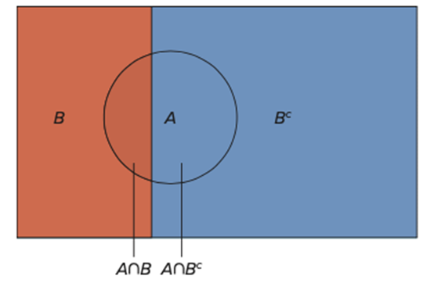
4.4 The Total Probability Rule and Bayes’ Theorem 2
The total probability rule expresses the probability of an event, A, in terms of probabilities of the intersection of A with any mutually exclusive and exhaustive events.
The total probability rule based on two events,
is given by
We can also use the multiplication rule to obtain the joint probabilities
Access the text alternative for slide images.

Slide 43
4.4 The Total Probability Rule and Bayes’ Theorem 3
Bayes’ theorem is a procedure for updating probabilities based on new information; it uses the total probability rule.
The original probability is an unconditional probability called a prior probability, in the sense that it reflects only what we know before the arrival of new information.
On the basis of new information, we update the prior probability to arrive at a conditional probability called a posterior probability.
The posterior probability
can be found using the information on the
prior probability
along with conditional probabilities as,

Slide 44
4.4 The Total Probability Rule and Bayes’ Theorem 4
Example: In a lie-detector test, an individual is asked to answer a series of questions while connected to a polygraph (lie detector).
This instrument measures and records several physiological responses of the individual on the basis that false answers will produce distinctive measurements.
Assume that 99% of the individuals who go in for a polygraph test tell the truth.
These tests are considered to be 95% reliable.
In other words, there is a 95% chance that the test will detect a lie if an individual actually lies.
Let there also be a 0.5% chance that the test erroneously detects a lie even when the individual is telling the truth.
An individual has just taken a polygraph test and the test has detected a lie. What is the probability that the individual was actually telling the truth?

Slide 45
4.4 The Total Probability Rule and Bayes’ Theorem 5
Example continued,
Let D and T correspond to the events that the polygraph detects a lie and that an individual is telling the truth,
We formulate
We can use Bayes’ theorem to find,

Slide 46
4.4 The Total Probability Rule and Bayes’ Theorem 6
Example continued,
We can also use the below table to help solve the problem systematically.

Slide 47
4.4 The Total Probability Rule and Bayes’ Theorem 7
We can extend the analysis to include an n mutually exclusive
and exhaustive events

Slide 48
4.4 The Total Probability Rule and Bayes’ Theorem 8
Example: Scott Myers is a security analyst for a telecommunications firm called Webtalk.
Although he is optimistic about the firm’s future, he is concerned that its stock price will be considerably affected by the condition of credit flow in the economy.
He believes that the probability is 0.20 that credit flow will improve significantly, 0.50 that it will improve only marginally, and 0.30 that it will not improve at all.
He also estimates that the probability that the stock price of Webtalk will go up is 0.90 with significant improvement in credit flow in the economy, 0.40 with marginal improvement in credit flow in the economy, and 0.10 with no improvement in credit flow in the economy.
Based on Scott’s estimates, what is the probability that the stock price of Webtalk goes up?
If we know that the stock price of Webtalk has gone up, what is the probability that credit flow in the economy has improved significantly?

Slide 49
4.4 The Total Probability Rule and Bayes’ Theorem 9
Example continued,
Use the multiplication rule to get the joint probabilities, for example,
Then find
Lastly,

Slide 50
4.5 Counting Rules 1
In several areas of statistics, for example. the binomial distribution, calculating probabilities involves defining and counting outcomes.
Factorials.
Combinations.
Permutations.
The number of ways to assign every member of a group of size n to n slots is calculated using the factorial formula.
By definition
This gives the number of arrangements of the n items.
We apply the factorial when there no groups.

Slide 51
4.5 Counting Rules 2
Example: a little-league coach has nine players on his team and has to assign each of the players to one of the nine positions. In how many ways can the assignments be made?
The first player may be assigned to nine positions.
Then eight remain for the second player.
Then seven for the third player and so on.

Slide 52
4.5 Counting Rules 3
The combination formula applies to two groups of predetermined size.
The order of the arrangement does not matter.
The number of ways to choose x objects from a total of n objects, where the order does not matters, is calculated using the combination formula.

Slide 53
4.5 Counting Rules 4
Example: the little-league coach recruits 3 more players, now his team totals 12.
How many ways can the coach select nine players from the 12-player roster?
This places 9 players on the field with no concern for position.

Slide 54
4.5 Counting Rules 5
The permutation formula applies to two groups of predetermined size.
The order of the arrangement matters.
Look for a specific reference to the order being important.
The number of ways to choose x objects from a total of n objects, where the order does matter, is calculated using the combination formula.

Slide 55
4.5 Counting Rules 6
Example: the little-league coach recognizes that the nine positions are different.
How many ways can the coach assign his 12-player roster to the 9 different positions?
There is a big different between the number of combinations and permutations!

Slide 56
End of Main Content
Copyright 2022 © McGraw Hill LLC. All rights reserved. No reproduction or distribution without the prior written consent of McGraw Hill LLC.

Slide 57
Accessibility Content: Text Alternatives for Images

Slide 58
4.2 Rules of Probability 7 – Text Alternative
Return to parent-slide containing images.
Venn diagram showing two nonoverlapping circles: A and B. Circle A is red. Circle B is blue.
Return to parent-slide containing images.

Slide 59
4.4 The Total Probability Rule and Bayes’ Theorem 2 – Text Alternative
Return to parent-slide containing images.
The Venn diagram shows a rectangle that is divided into two sections with differently colored. The smaller section on the left is labeled B and the larger section on the right is labeled B superscript c. A circle inside this rectangle is labeled A which covers both the sections. The smaller section of the circle on the left is labeled A intersection B and the larger section of the circle on the right is labeled A intersection B superscript c.
Return to parent-slide containing images.

